Slide 1
Identifying users' topical tasks in web search
Date: 2013/12/25
Author: Wen Hua, Yangqiu Song, Haixun Wang, Xiaofang Zhou
Source: WSDM’13
Advisor: Jia-ling Koh
Speaker: Sz-Han Wang

Slide 2
Outline
Introduction
Method
Similarity Calculation
Task Identification
Experiments
Conclusion

Slide 3
Introduction
Motivation
A search task represents an atomic information need of a user in web search.
Identifying tasks is important for search engines
Notes:
*一個search task呈現了使用者在搜尋網站上需要的資訊
*因此task的辨識對搜尋引擎來說是很重要的，可以提供有價值的資訊，讓使用者決定搜尋結果的滿意度，並預測了使用者的意圖，提供建議的query給使用者

Slide 4
Introduction
Tasks are better information units than single queries or sessions.
query: “flight to LA”
single-query-based: recommend a query “cheap US flight”
session-based : also recommend a query “hotel in LA”
session contain queries with multiple user intents
Notes:
有研究指出，task比起單一query或session，是比較好的訊息單元
session-based : “hotel in LA”在”計畫去LA旅行”的task中
Session的問題是一個session裡的query可能會包含許多使用者不同的意圖，如果不加以區別的使用這些query可能會推薦和原來query不相關的quer
而task則是在一個時序內的query，彼此之間是有相關的

Slide 5
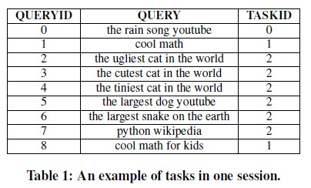
Introduction
Task identification itself is far from simple, due to the following reasons:
not trivial to decide whether two queries belong to the same task
→need a semantic mechanism to identify topical query refinements.
queries 4, 5, and 6 in Table 1 may
belong to the same task
“cat” , “dog” and “snake” may be of the
same topic (“animal”)
Notes:
*因為以下3個原因辨識task是一件不簡單的事
*第一個原因，決定2個query是否屬於同一個task很不trivial
需要一個語意機制來辨識query refinements的主題

Slide 6
Introduction
inferring semantics from a query or a short piece of text is a complex task.
Lucchese et. al. address this problem by simply mapping each word in a query to a set of Wikipedia articles that contain the word.
tasks in one session may interleave
Sequential Cut
Graph Cut algorithm
tiger
concept-animal
tiger woods
woods
concept-material
Notes:
*第二個原因:重一個query或是一則短篇文字中來推斷語意是很複雜的工作
在過去 爐闕賽 利用簡單的對照query中每一個單字在wikipedia文章中出現過的字
會造成許多字的模糊
*第三個原因是task在一個session中可能會交錯
過去的作法sequential是選擇忽略這個問題
後來有人提出Graph Cut algorithm，能正確的解決task交錯的問題，不過會產生2個問題
1.過度合併
2.花費太多的時間計算

Slide 7
Introduction
session
1. Similarity Calculation
Task 1
q1
q1
Conceptual Features
q2
q3
2. Task Identification
Lexical Features
Supervised machine learning process
Sequential Cut and Merge
q3
Template Features
Task 2
q2
q4
Temporal Features
q4
Notes:
•採用lexical, conceptual, template and temporal features 來計算query的相似度，用來評估兩個query是否該被分再同一個task
*利用Probase來建立概念機制來推斷query的基本概念含意
•使用multi-word terms而不是single words來辨識query所包孩的主題 ，並且會交叉主題相關的概念，強調共同概念，降低query的模糊性
•介紹Sequential Cut and Merge (SCM) algorithm 來辨識交錯的task

Slide 8
Outline
Introduction
Method
Similarity Calculation
Task Identification
Experiments
Conclusion

Slide 9
Probase
A huge semantic network
Node divided into three categories
entities (e.g., “Barack Obama”)
concepts (e.g., “President of America”)
attributes (e.g., “age”, “color”)
Edges represent the relationships between nodes
isAttributeOf between attributes and concepts
(e.g., “ population” isAttributeOf “country”)
isA between entities and concepts
(e.g., “Barack Obama” isA “President of America”)

Slide 10
Similarity Calculation
Conceptual Features
Step 1: Parsing
“truck driving school pay after training”
→ “truck driving”, “driving school”, “pay”, “ training”
Step 2: Conceptualization
T=(t1,t2,t3….) C=(c1,c2,c3…)
“microsoft windows 7” → “microsoft” → “operating system”
“windows 7” → “operating system”
“alabama home insurance” → “alabama” → “ state”
“home insurance” → “insurance” & “benefits”
Step 3: Calculating conceptual similarity
Notes:
*步驟一的時候會做解析
給一個query，會將它切成很多組term，每一組term切的概念是能對應到在Probase中最長的instance/attribute
*步驟二:概念化
在parsing後一個query會有很多的instance/attribute，將它定義為T，我們想要得到代表這些instance前K個concept，這些concept都是在probase內可以找到的
*步驟三:計算query概念的相似度

Slide 11
Similarity Calculation
Lexical Features
N-word Jaccard
Step 1: divide the bag-of-words representation of a query into a collection of N-words
e.g., “the car james bond drive”
{“the car”, “car james”, “james bond”, “bond drive”}
Step 2: calculate the N-word similarity between two queries with term frequencies
Step 3:range the value of N from 1 to 5, and get five N-word Jaccard similarities for each pair of queries: sim1wj,sim2wj, . . . , sim5wj
N-char Jaccard
Notes:
計算N-word Jaccard和N-char Jaccard
在計算N-word Jaccard時分為3個步驟
步驟一:將queryN個字N個字切
步驟二:計算N-word的相似值，兩個字同持出現的機率
步驟三:以N從1算到5帶入，做步驟一和二
N-char Jaccard是和N-word Jaccard相同的方式，只是但未從單字變成單個字符

Slide 12
Similarity Calculation
Template Features
formulate templates of query refinements as a similarity function based on Levenshtein edit distance
e.g, kitten → sitting , edit distance=3
Temporal Features
the more temporally close two consecutive queries are, the larger the probability of them belonging to the same task
Notes:
Template Features
在query logs中query refinement的策略是非常的普遍的
利用Levenshtein edit distance制定templates來計算query refinements 的相似度
Temporal Features
時間越靠近的兩個連續query，屬於同一個task的機率越大，越相似

Slide 13
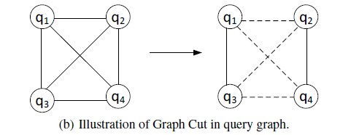
Task Identification
Merge queries with significant similarities into one task
Sequential Cut
Assume tasks are never interleaved with each other
Try to detect task boundaries between consecutive queries
Graph Cut algorithm
To detect interleaved tasks
Notes:
使用supervised machine learning process整合4個feature的相似度，得到每個query之間的整體相似度
Task Identification將明顯相似的query分為同一個task

Slide 14
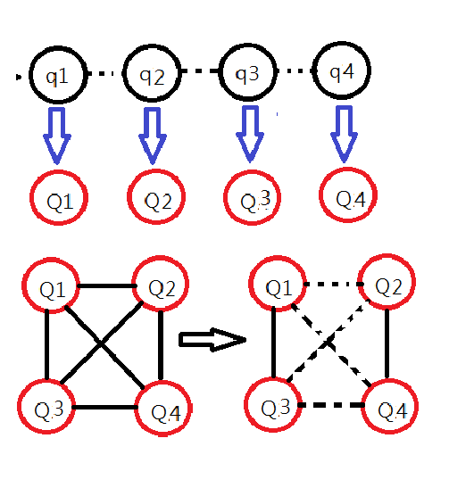
Task Identification
Sequential Cut and Merge
Combination of SC and GC
Apply SC on the target session and refer to the task derived from SC as subtasks.
Apply GC to the set of subtasks
Notes:
Apply GC to the set of subtasks:建立subtask graph

Slide 15
Outline
Introduction
Method
Similarity Calculation
Task Identification
Experiments
Conclusion

Slide 16
Dataset
All the session one day in May 2012 from a commercial internet
Session: a sequence of queries issued in the browser without the use closing it
Constraints:
Users in the “United Stated”
Queries be written in “English”
Each session contained at least 10 queries
After filtering obtain 45,813 sessions
Randomly sample 600 sessions

Slide 17
Evaluation metrics
Effectiveness of Classifiers and Features
Error Rate
Accuracy of Algorithms
F-measure
Jaccard Index

Slide 18
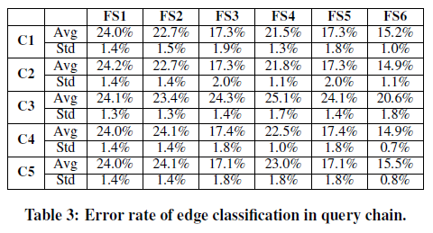
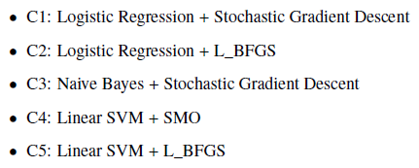
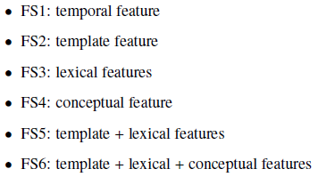
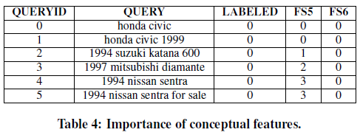
Effectiveness of Classifiers and Features
Notes:
*C1~C5使用3個典型的分類方法結合3個優化方法
FS1~FS6使用不同feature的結果
*為了再次確認conceptual的重要性

Slide 19
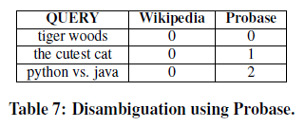
Effectiveness of Classifiers and Features
 | Wikipedia | Probase
tiger woods | “tiger” → “tiger” “animal” “woods” → “material” “plant” | “golfer” or “athlete”
the cutest cat | “cat” or “animal” | “cat” or “animal”
python vs. java | “snake” or “animal” “programming language” | “python” → “snake” “programming language” “java” → “programming language”

Slide 20
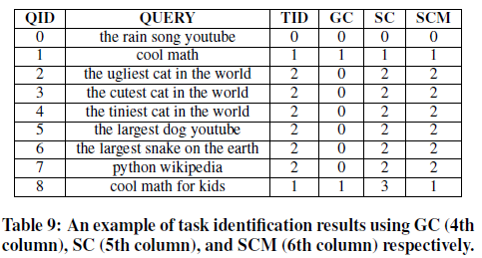
Accuracy of Algorithms

Slide 21
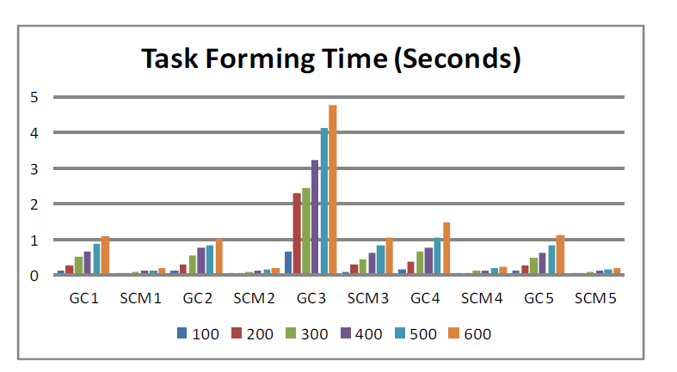
Accuracy of Algorithms

Slide 22
Outline
Introduction
Method
Similarity Calculation
Task Identification
Experiments
Conclusion

Slide 23
Conclusion
Improve the performance of task identification
Exploit Probase to reduce query ambiguity.
Build a Sequential Cut and Merge (SCM) algorithm
Prove that SCM can detect interleaved tasks and thus retrieve comparable or even better performance, compared with GC.
The queries contained in some tasks are related to each other, rather than similar. Probase doesn’t have any mechanism to calculate the relatedness score of each query pair. We leave it for future work.

